Slide 1
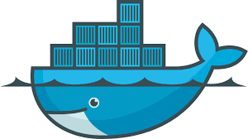
Docker Containers
Why they matter and what you need to know
Nick Ramirez

Slide 2
Agenda
What’s the big picture?
Why would I use Docker?
What lessons can we draw from the shipping industry?
Demo of Docker

Slide 3
What can we learn
from real-life shipping containers?
Notes:
There’s a reason why Docker has chosen to use so much imagery from the real-life world of freight handling and shipping containers: The benefits realized by one are closely analogous to the other.

Slide 4
Point 1
For easier, cheaper shipment
you need a standard-sized box.
There is an ISO standard for shipping containers.

Slide 5
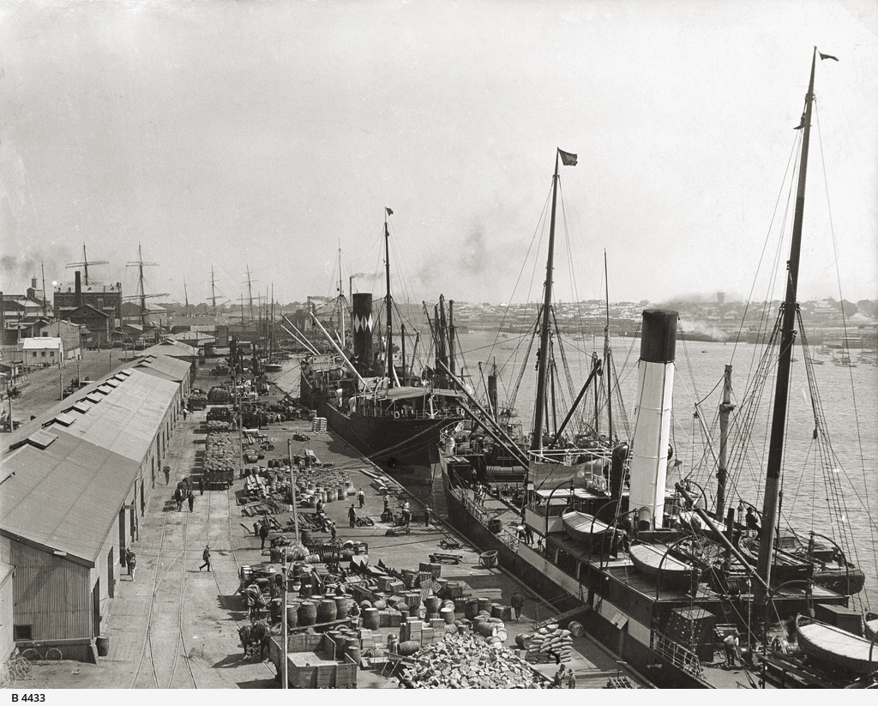
Before the standard
Notes:
1927, Queen’s Wharf, Australia
In this picture, you see workers loading cargo onto ships. The cargo is stored in bags, barrels and boxes of various shapes and sizes. Loading this cargo so that space is used effectively takes some thought because it’s not all one size.
Notice that the cargo is stored in the hull of the ship, the cargo hold, where it’s not exposed to the elements – so, the amount of cargo you can carry on a ship is determined by the size of the cargo hold.
There’s no isolation between the products. You might have cars being shipped next to building materials, bannanas being shipped next to casks of oil.
Above all, loading this cargo was time and labor intensive, and costly.

Slide 6
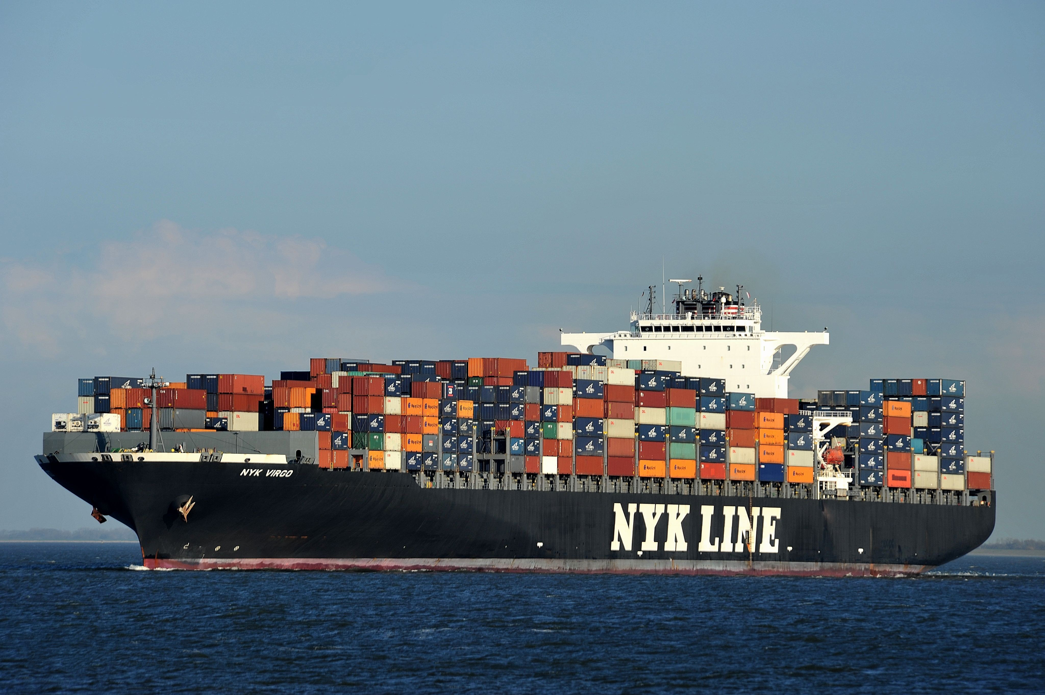
With a standard
Notes:
The shipping container has revolutionized how products are shipped around the world. It’s faster and less expensive to load a shipping container because it’s a standard shape and size.
Cost to load went from $5.86/ton to 16 cents per ton.
You needed fewer people to do the work. The ship was redesigned to stack containers on top of it (because we know ahead of time what these containers are going to look like).
Shipping companies could use their ships to full capacity, which is easier to plan for and make happen when you start with a standard sized box.
Also note that we get better isolation between the products being shipped.

Slide 7
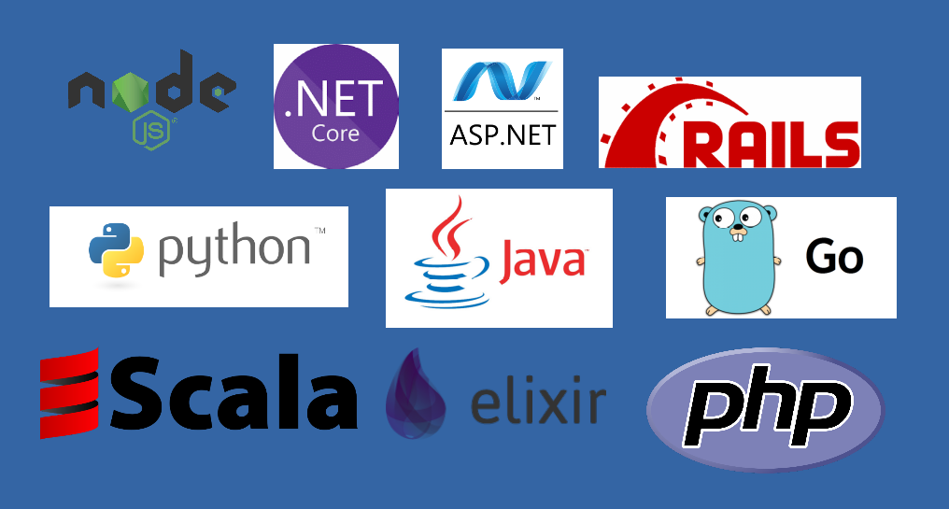
Do we have a standard shape and size when shipping code?
Notes:
Do we have a standard shape and size when it comes to code?
We might have a node.js app running next to a .NET app, or a PHP app running next to a Python one. The steps to deploy one is going to be vastly different from deploying the other.
Same as it was in the shipping industry, this lack of a standard-sized box means it’s more time and labor intensive to get these applications deployed correctly.
If you’ve been involved in deploying a .NET application, you know that IT operators typically need some lead time to get the machine provisioned with IIS, .NET and any extras like software dependencies that have to be installed separately. Then the app pool has to be tuned, the website, app pools, etc. set up. That takes time to get right. Sometimes, there are kinks to work out.
Then, the developers come back later and say, “We’re deploying a node.js app. Forget everything you know.”
Also, when it comes to isolation, unless you’re deploying each one to its own host virtual machine, you have to worry about how one might affect the other by living on the same system. And how will the system affect these applications? Will my app live through the next Patch Tuesday?

Slide 8
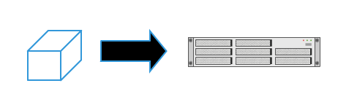
A Docker container is a standard-sized box to deploy
Docker run -d -p 80:80 –name myapp hmbinc/webapp
Notes:
Software becomes a black box where operators don’t need to know how the internals work.
Deploying becomes a standard set of commands to deploy the box: “docker run”
Every box is the same shape and size, so to speak.
Software is isolated within its container from other software in other containers.
HOW IS THIS DIFFERENT FROM A VIRTUAL MACHINE?
Virtual machines run on top of a virtualization layer that runs on top of the host operating system. A Docker container plugs directly into the operating system kernel and acts more like a native process, but with its own file system, TCP ports, network space, and environment.

Slide 9
Point 2
The details of packing containers can be done far from the loading dock.

Slide 10

Complexity at the dock
Notes:
The life of a dock worker (or an IT operator) before containerization.
Complexity! Complexity! Complexity!
When your job involves deploying a wide range of products, you can’t really optimize. You’re down in the weeds every day.
Want to try automating this task? It’s not so easy when one day you’re lifting bags of flour and the next you’re rolling casks of oil or lifting piles of lumber.

Slide 11
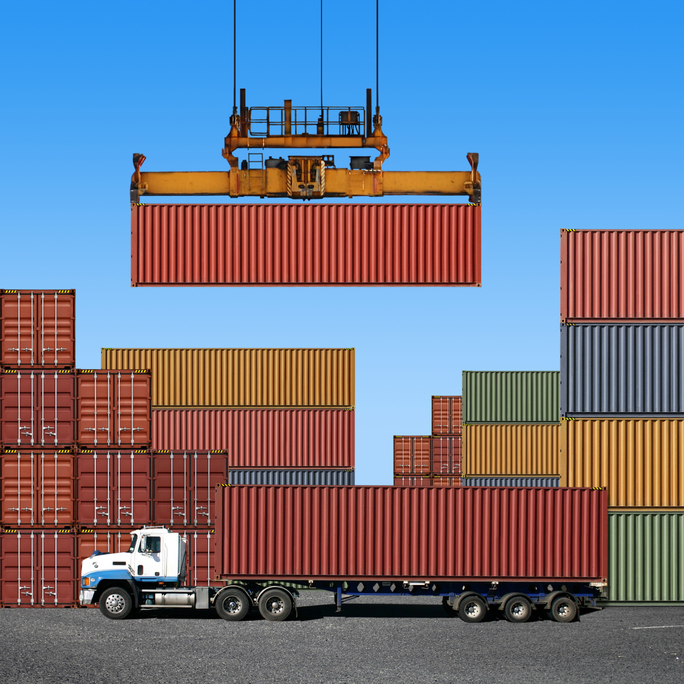
Complexity abstracted away
Notes:
With containers, we take that complexity away from the point of deployment. We’re not dealing with the complexity at the point of departure...or when we’re putting the software onto the server. We’re dealing with that beforehand.
In software development, we no longer want to give operators a bunch of files or even a non-standard package. The operator should say, “Come back to me once you have a standard-sized container. I will accept no substitute.”
Why?
The benefits of packing shipping containers beforehand are:
Complexities of loading the cargo is handled off-site and it’s guaranteed to work in any environment that supports the Docker platform.
Deployment time and cost goes way down.
We can iterate faster. Which means we can take more risks and introduce innovation.
The dependencies of an application are made more explicit. We don’t have to wonder what’s on that system that makes it work?

Slide 12
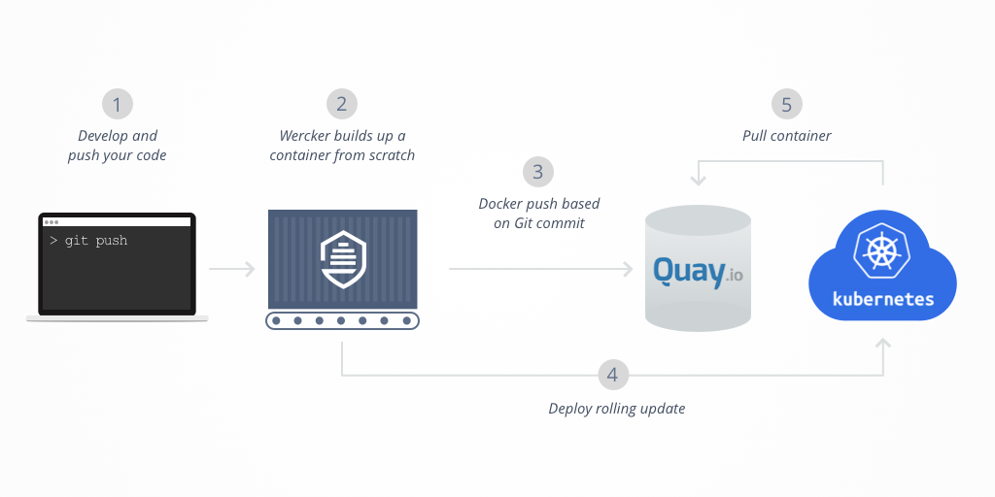
Notes:
Step 1: You develop your application and container on your dev machine. You can use “docker volumes” to keep pushing code that’s still a work-in-progress into a running container.
Step 2: commit the code to git and there should be a trigger that compiles your code, runs tests and then builds a Docker image with your application inside of it. (I like Gitlab for this, but most major CI vendors are adding Docker support)
Step 3: push that new Docker image to a container registry like Quay.io or a self-hosted registry.
Step 4: Have your CI system tell your scheduler, which will likely be Kubernetes, to pull the latest image and do a rolling update of your application using the new image.

Slide 13
Point 3
Containers change the profession
of operators.

Slide 14
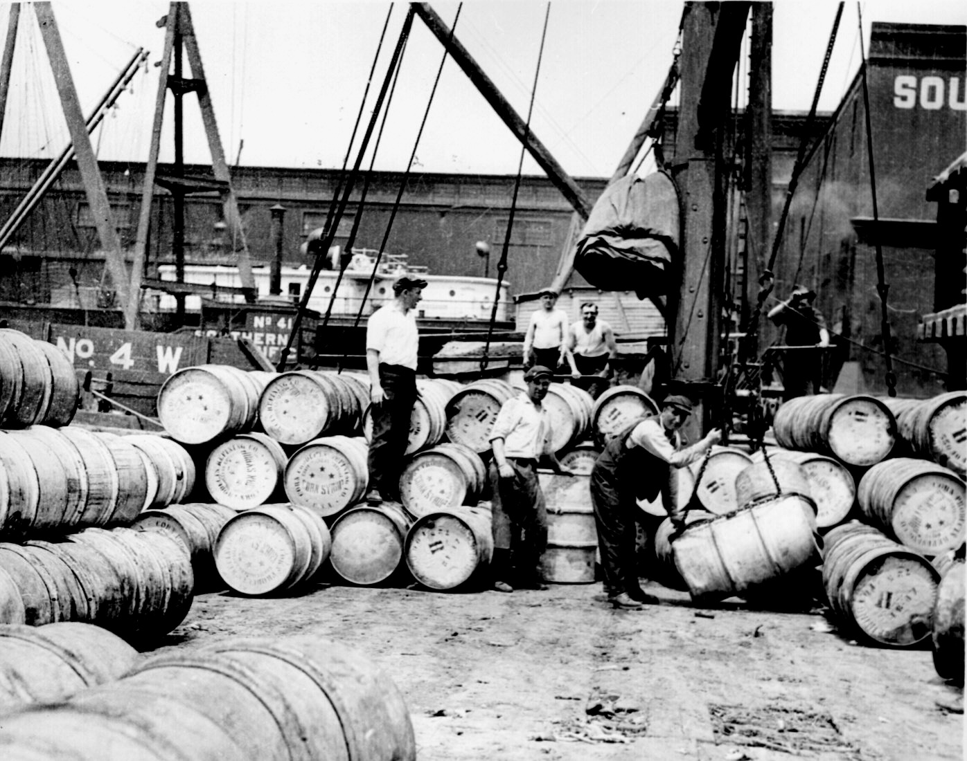
Time-consuming work
Notes:
The life of an operator without a standard interface for shipping is a labor-intense one where you’re never out of the weeds quite long enough to introduce innovatation into your infrastructure.
Developers have to go to the IT staff and pass knowledge to them about how their software should be hosted and what its dependencies are.
Oftentimes, neither developers nor operators know what the dependencies are.

Slide 15
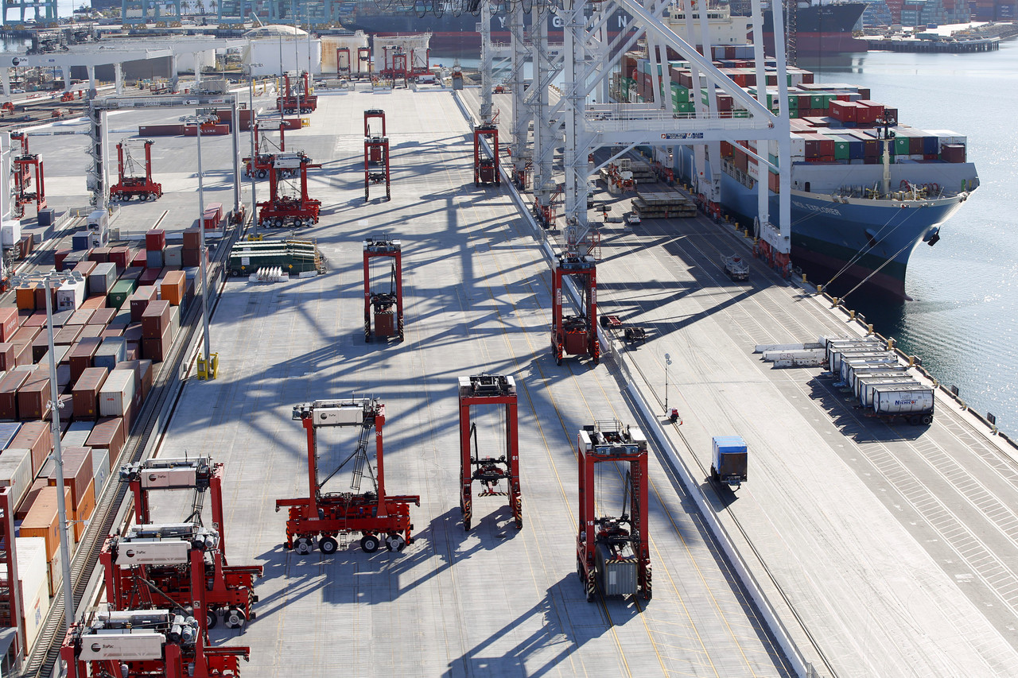
Platform specialists
Notes:
In this picture: Robots are finding and loading shipping containers.
One person in a control booth manages the automation.
IT operators who use containers will see their jobs change. It will be less about being in the weeds and more about big picture stuff like building and improving the platform that the containers run on.
Shipping containers:
Specialized cranes …
Trucks that containers can be easily lifted onto and from ...
Ships built to hold containers …
Software:
Automatic scaling of containers instances, scheduling onto a farm of servers, improving network resilience...
A different kind of job for operators:
Opportunities for innovation and automation at the platform level.
Lower operating cost.
Standardization on delivery, security, and monitor-ability.

Slide 16
After containers, start tackling the more interesting problems
Abstract away the host machine (Docker)
Abstract away scheduling a container onto a server in a datacenter and service discovery (Kubernetes, Swarm, DC/OS)
Abstract away the networking problems and authorization (Istio, Linkerd)
Abstract away storage (Portworx, Flocker, GlusterFS)

Slide 17
Think differently about containers
Containers should be thought of as immutable. Don’t update or patch them. Alway replace.
Save your Dockerfile and other configs in source control.
Think of containers as processes and not VMs.
Remember that Linux containers only run on Linux and Windows containers only run on Windows.
A container is not accessible by default. You don’t have to expose a container to the outside world.

Slide 18
Demo!!!

